Slide 1
Context study:
‘Justice’

Slide 2
Resources required for this unit:
You will need this PPT
You will receive a booklet on ‘Justice’
Your teacher will show you several ‘youtube’ clips, when it suits the lesson.
A ‘To Kill a Mocking Bird’ study guide.
You will receive ‘how to complete…’ PPTs/worksheets, for the various assessments.

Slide 3
Today’s lesson
You will consider ideas around justice.
Form a group of 3-4 students, you will need to work with your group to discuss the slides/questions and how they relate to justice.
Work through each of the following slides. For each question posed think about it individually, record your thoughts where prompted and then discuss information as group.

Slide 4
Justice
Write a definition of the word ‘justice’.
What does justice mean to you?
Brainstorm what justice is– you may use https://bubbl.us/mindmap and add this image to your justice page.
Now share ideas with your group.
1 of you come up and write your ideas on the board.
WRITE THIS INFORMATION ON YOUR‘JUSTICE’ PAGE

Slide 5
Justice
just behaviour or treatment: "a concern for justice, peace, and genuine respect for people"
synonyms: | fairness, justness, fair play, fair-mindedness, equity, equitableness, Even-handedness, egalitarianism, impartiality, impartialness, lack of bias, objectivity, neutrality, disinterestedness, lack of prejudice, open-mindedness, non-partisanship; More

Slide 6
Justice Pictures.
In your group, spend no more than 30 seconds looking at each of the following slides
discuss and record ideas on what the picture presents about justice.

Slide 7
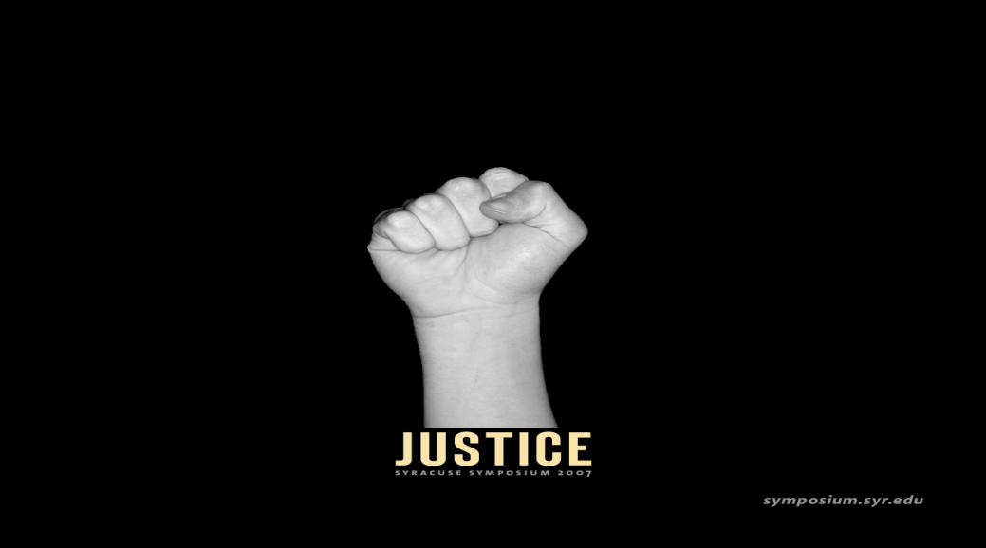
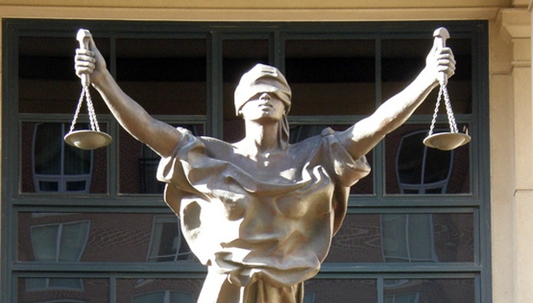
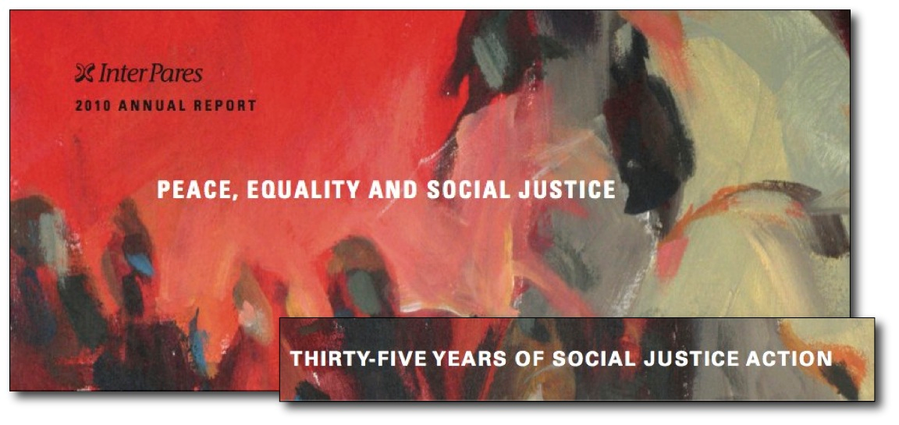
What does this mean???

Slide 8
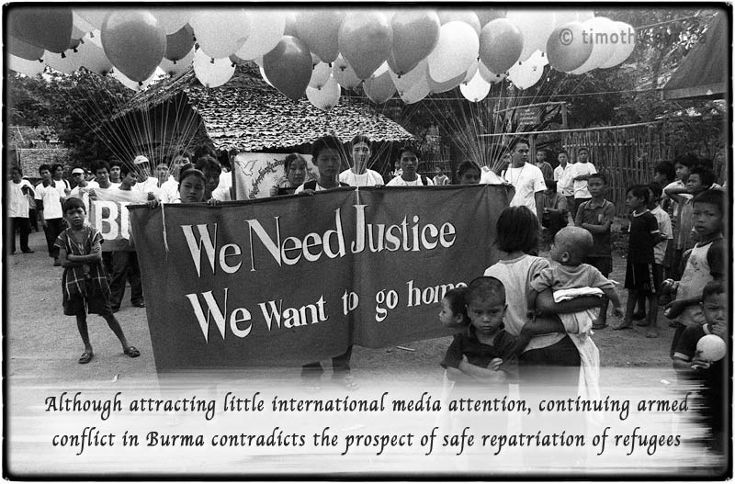
What does this mean???

Slide 9
‘Justice'

Slide 10
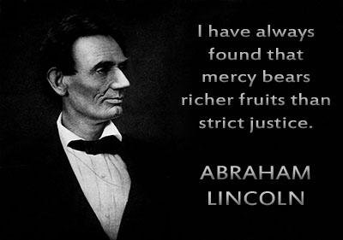

Slide 11
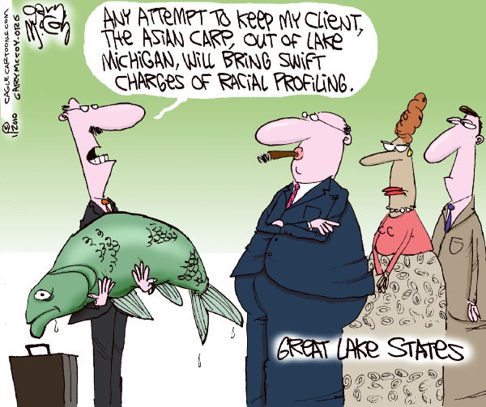

Slide 12
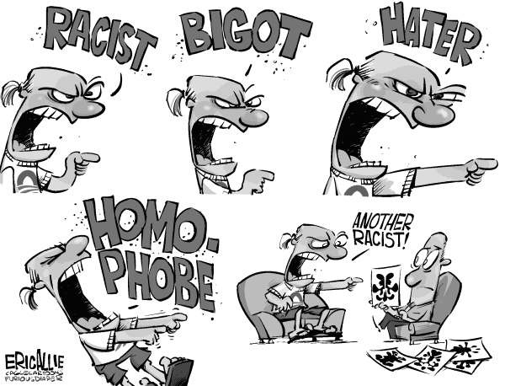

Slide 13
Break into pairs and write a definition in your own words the following:
Injustice
Society
Prejudice
Equality
ADD THIS INFORMATION ON YOUR‘JUSTICE’ PAGE

Slide 14
Feedback
Now join back with your group of four and debate your answers to find a common definition of those words.
Provide an example of each one.
Write down other groups definitions that resonate with you personally.
ADD THIS INFORMATION ON YOUR‘JUSTICE’ PAGE

Slide 15
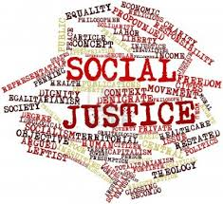
Now onto the class details for this unit.

Slide 16
The context: ‘Justice'
... What is it?
The Context Study is an exploration of an idea or concept that focuses on learning how to write about those ideas through studying a core text and others that might contribute not just ideas but possibilities for writing.
Our context is ‘Justice’.
This is a very philosophical context; one that will test your thinking.
It is asking you to explore what is consider what is Justice? How does society decide what is Justice? Is this actually possible or realistic? What is the reality of justice and what is prejudice, are they too subjective? Hence-the perceptions of justice may in fact be an illusion.
The core text is…………

Slide 17
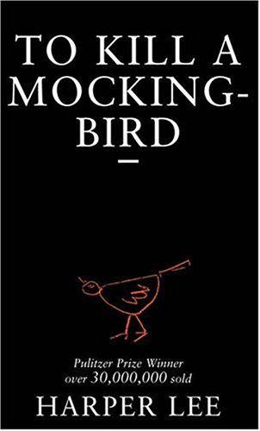
To Kill a Mockingbird – By Harper Lee We will be exploring what Harper Lee (who wrote the novel) is suggesting about Justice.

Slide 18
Why?
The purpose of studying various texts within a context is to provide you with stimuli to create writing pieces are interesting, well written and explore the context question.
By exploring the social, historical, cultural dimensions of the context and subjective nature of reality/normality, you should gain an understanding of question posed and form some key ideas. The text ‘To Kill a Mocking Bird’ will be used to explore one perspective of ‘Justice' and the underlying issues.
Also, this understanding of context will give you an excellent grounding into VCE unit 1 - which you will be studying next year.

Slide 19
How do I create context pieces? What is expected?
Section B context writing:
Prompt: ‘Have you ever been treated unfairly because of your race, your religion, the way you look, or just because you are "different"? Unfortunately, many of us have. Tell about a time you were treated unfairly. How did you react? How did it make you feel? .’
↓
Ideas from you: do you agree/disagree with the prompt?
↓
Ideas from the text ‘To Kill a Mockingbird’ that explore the prompt. You can refer to the text directly by exploring what it is Lee presents. Or, you can refer to a theme, such as Prejudice, from the text, to discuss in your piece.
↓
Ideas from your context folder on ‘Justice'. e.g. articles, songs, TV shows etc-so get exploring! There are some ideas in this ppt/booklet
↓
Now collate your ideas into a piece of writing, exploring the prompt.

Slide 20
How?
TEXTS
To Kill a Mockingbird
Short related texts.
CONTEXT
KEY IDEAS FROM ‘Justice'. .
WRITING PIECES TBC
(remember you will also write a statement of I/E.)
Short story
Feature Article
Oral presentation that will use this as an issue and link to context.

Slide 21
What are the assessment tasks?
An opinion article. Your article will address the prompt and you will the text and your resources from your context folder to explore and form an opinion piece (see assessment sheet for structure.
An oral presentation and website. You will also make a website that will be your context folder which will demonstrate all your knowledge of this context. You will complete an oral by presenting your website to the class.
The exam. In the exam you will need to write a memoir based on the context, prompt and text (planning sheets to come).

Slide 22
Studying the context
The next part of this PPT is to get you exploring ideas on justice.
These ideas and explorations will help you for most of your assessment tasks.
You need these ideas because your assessment cannot just rely on ‘To Kill a Mocking Bird’, because this assignment is not a text response.
Let’s get started!

Slide 23
How do we decide what is right and wrong? How do we decide what is justice and injustice?
When we explore ‘To Kill a Mocking Bird’, the text explores how attitudes in society define what is right and wrong, but more concerning, it explores who decides this and what it means for those who receive justice.

Slide 24
What Is Society?
A system of social interaction that includes culture and social organisation.
interact and communicate with each other
share goals and norms
are aware of themselves as a distinct social unit
Members of a society have a common culture though there may be great diversity within it.
Discuss with a partner: How is Australian society diverse?
What are the advantages and disadvantages of a diverse culture?
Who are the people with power and no power
ADD THIS INFORMATION ON YOUR‘JUSTICE’ PAGE

Slide 25
The Socialisation Process
Humans learn the expectations of society through socialisation.
Socialisation is different based on race, gender and class-can you describe yourself here?

Slide 26
Consequences of Socialisation
Establishes self-concepts.
Creates the capacity for role taking.
Creates the tendency for people to act in socially acceptable ways.
Makes people bearers of culture.
Punishes those who go against what is deemed right.

Slide 27
Social Institutions In groups of 3-4, by each institution, explain how they have power and influence our understanding of justice.
Family
Education
Work
Economy
Political Institutions
Religion
Health care
Mass Media
Sports
Military
ADD THIS INFORMATION ON YOUR‘JUSTICE’ PAGE

Slide 28
Agents of Socialisation
Institutions pass on expectations about appropriate social behavior:
Family
Media
Peers
Religion
Sports

Slide 29
The Family
Families introduce children to the expectations of society.
How parents define and treat a child is crucial to the development of the child’s sense of self.
Some families emphasize educational achievement; some may be more permissive, whereas others emphasize strict obedience and discipline.
Describe a family experience/event when you first learnt something was wrong. What did you learn about justice (or injustice)?
ADD THIS INFORMATION ON YOUR‘JUSTICE’ PAGE

Slide 30
Polling Question
Which media source do you think has the strongest impact on attitudes and behaviors of your generation?
Advertising
Television
Music and music videos
The Internet
Magazines
For each of the above, describe how each one influences you.
ADD THIS INFORMATION ON YOUR‘JUSTICE’ PAGE

Slide 31
Peer pressure and school life Peers
For children, peer culture is an important source of identity.
Through interaction with peers, children learn concepts of self, gain social skills, and form values and attitudes.
Girls’ peer groups tend to be closely knit and egalitarian.
Boys’ peer groups tend to be more hierarchical, with evident status distinctions between members.

Slide 32
Schools
In school, teachers and other students are the source of expectations that encourage children to think and behave in particular ways.
Research finds that teachers respond differently to boys than to girls, with boys receiving more of their attention.
The hidden curriculum consists of the informal and often subtle messages about social roles conveyed through classroom interaction and materials.

Slide 33
Looking at schools and peers
Which one puts more pressure on you for how you should behave? Explain your answer with an example.
How do they both influence your learning with justice and injustice?
ADD THIS INFORMATION ON YOUR‘JUSTICE’ PAGE

Slide 34
Group reflection
For each of the following slides, write your own individual response to the questions ask.
Then spend 5 minutes sharing/discussing your thoughts with your group.

Slide 35
What is ‘difference’?
Can you think of different groups in society you consider ‘different’?
Can your difference prevent you from doing things?
Can you think of any examples, big or small?

Slide 36
What is ‘prejudice’?
Can you think of different groups in society you consider ‘prejudiced’?
Can prejudice prevent you from doing things?
Can you think of any examples, big or small?
How were you answers similar of different to those you gave for ‘difference’?

Slide 37
What is this man’s story?

Slide 38
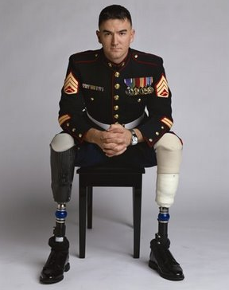
How about now?

Slide 39
For each of the following slides complete the following.
Individually consider/make notes
What does the slide suggest about justice or injustice?
Is there some one who is better off?
Who are victims/worse off?
Discuss with your thoughts with your group

Slide 40
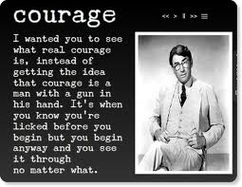
Notes:
JUSTICE. HE IS TELLING US THAT HE HAS THE COURAGE TO FIGHT EVEN KNOW HE WONT WIN. Quote from to kill a mocking bird. Perception on justice. “COURAGE”

Slide 41
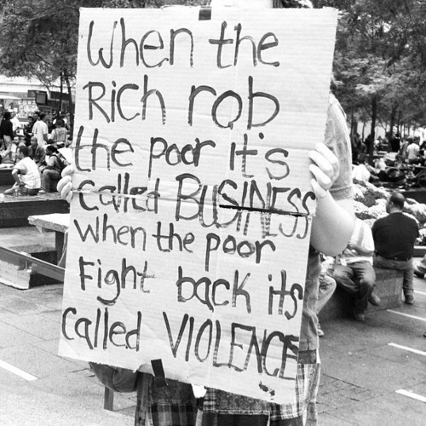
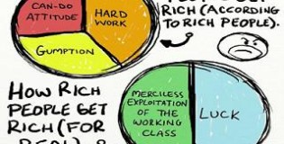
Rich vs Poor
Notes:
INJUSTICE. One side of society and different perspectives to different classes.

Slide 42
Notes:
INJUSTICE. Of white Australian's against black Australians by stealing there children.

Slide 43
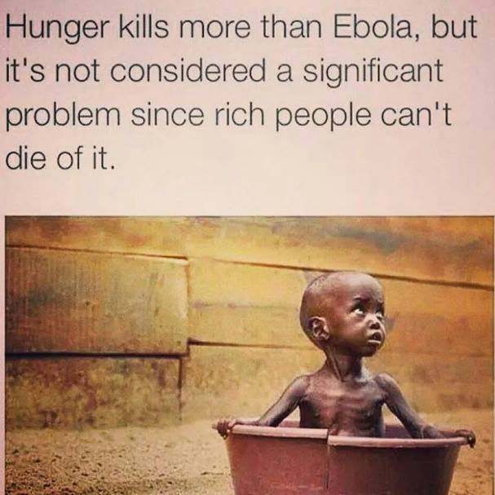
Notes:
INJUSTICE. The rich people are the ones who control the world and if the problem doesn’t affect them then its not important enough.

Slide 44
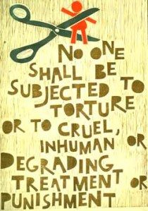
Notes:
INJUSTICE. Everyone should be ttreatred with equal rights but we know that they wont get treated equally

Slide 45
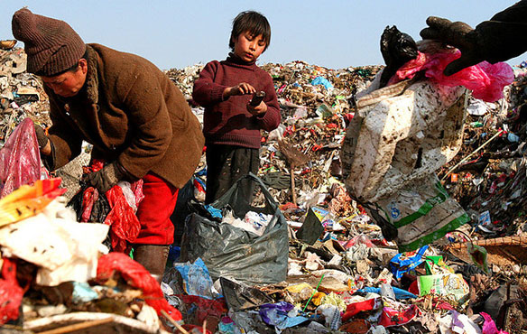
Notes:
INJUSTICE. Poverty livers the horizon, a child looking for things that they would never have, they are putting there kids into this to find himself food and things to sell to get money to buy things for themselves to live. We turn a blind eye

Slide 46
Notes:
JUSTICE. The world is very racist and shes not going to stop them she is going to go to school and get her education and be like everyone else. Talks of a third party, she won the nobel prize, she got shot by the telaband because she was trying to go to school, she is a symbol of freedom for girls

Slide 47
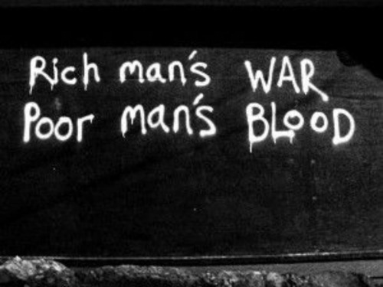
Rich vs Poor
Notes:
INJUSTICE. It shows how the government discriminates these poor people.

Slide 48
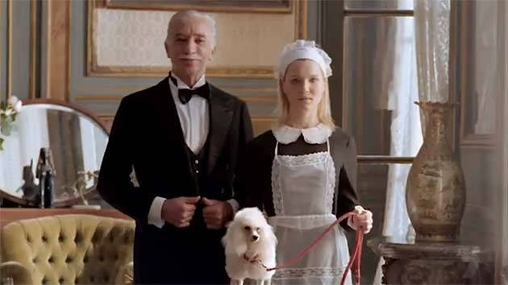
World’s richest dogs
In this entertaining special we take you on a barking mad journey across the globe to meet the world's richest dogs whose lifestyle must be seen to be believed!
Notes:
JUSTICE OR INJUSTICE. We have people straving to death and then there is this dog living in this wonderland

Slide 49
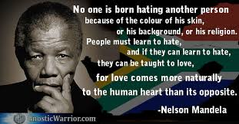
Notes:
JUSTICE . On how nobody is born with hate, racism

Slide 50
Will history repeat itself?
Notes:
JUSTICE. Hes fighting for the refugees and people in detention shelter hes referring to the stolen generation

Slide 51
Will history repeat itself?
Notes:
JUSTICE. Hes talking about there life is going to better than theres.

Slide 52
Different perspectives
Notes:
JUSTICE

Slide 53
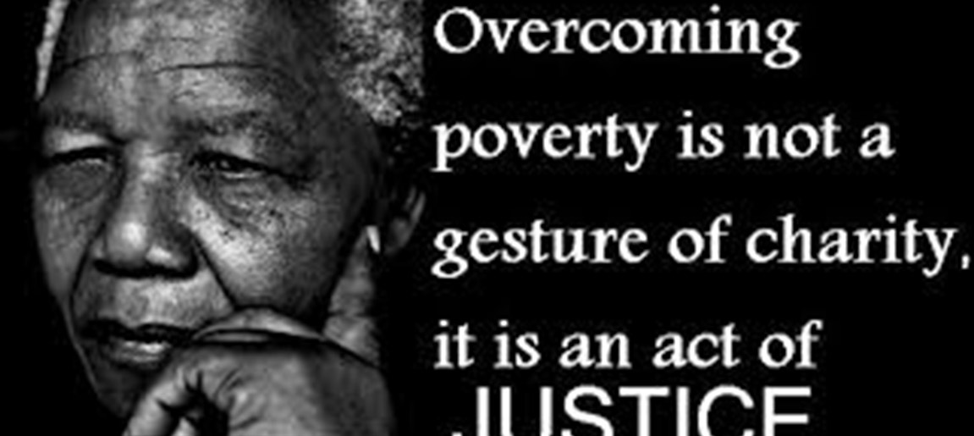
Notes:
JUSTICE

Slide 54
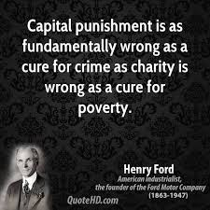
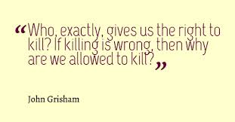
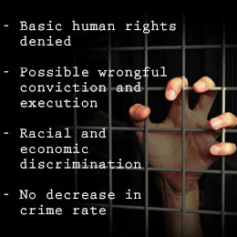
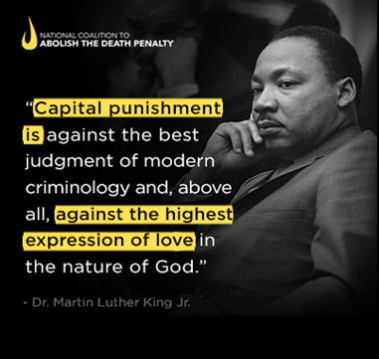
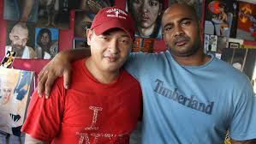
Notes:
JUSTICE

Slide 55
Why so hard to see black and blue? #TheDress used in domestic violence campaign http://www.smh.com.au/world/why-so-hard-to-see-black-and-blue-thedress-used-in-domestic-violence-campaign-20150307-13xrz0.html
Notes:
JUSTICE

Slide 56
Power of mobile uploads
Notes:
JUSTICE

Slide 57
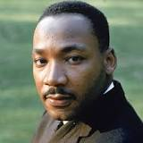
Martin Luther King Jr.
“I have a dream that my four little children will one day live in a nation where they will not be judged by the colour of their skin but by the content of their character.”
Notes:
JUSTUICE

Slide 58
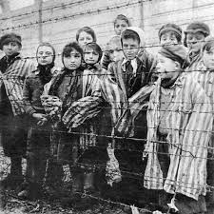
Tim Holden-the Holocaust
The Holocaust illustrates the consequences of prejudice, racism and stereotyping on a society. It forces us to examine the responsibilities of citizenship and confront the powerful ramifications of indifference and inaction.
Tim Holden
Notes:
INJUSTICE

Slide 59
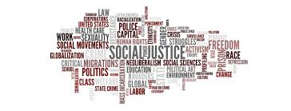
Notes:
JUSTICE

Slide 60
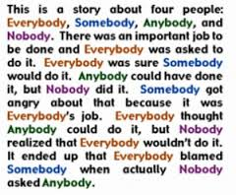
Notes:
JUSTICE

Slide 61
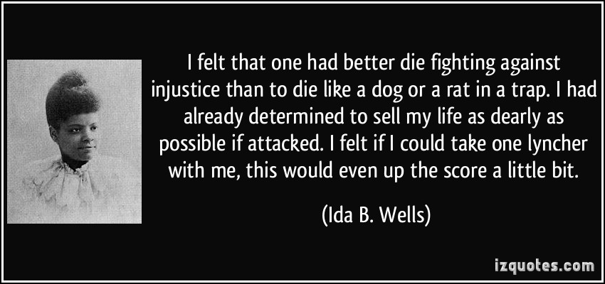
To finish off
Now that you have finished all this study, in your groups find a quote on justice and injustice.
Research an example of an act of justice and injustice in the world today.
ADD THIS INFORMATION ON YOUR‘QUOTATION’ AND ‘WIDER EXAMPLES’ PAGES
Peace and justice are two sides of the same coin.

